Slide 1
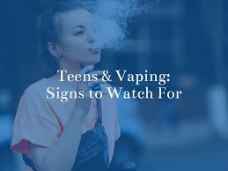
TEENS & VAPING
Tuesday Talks About Teens
12:00 – 12:30
June 16, 2020
Kathy Cody, LCSW,CASAC

Slide 2
What is vaping
It is the act of inhaling and exhaling the aerosol produced by an electronic vapor device when it heats the liquid ingredients.
E-cigarettes are battery-powered devices that heat flavored nicotine into an inhalable aerosol.
E-cigarettes are often referred to as vaping. JUUL is currently the most popular brand of vaping device for teens and young adults. “JUULING” is the term used for e-cigs.

Slide 3
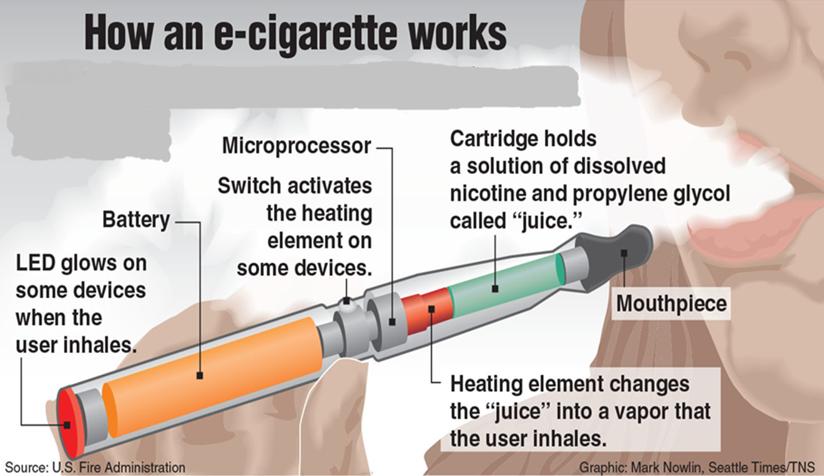

Slide 4
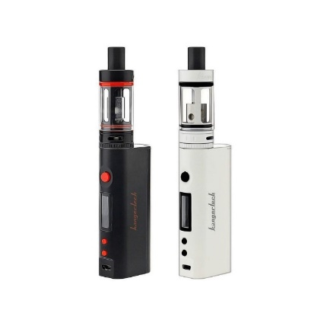
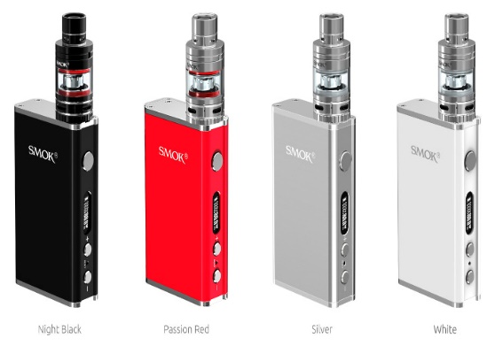
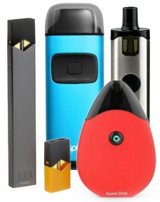
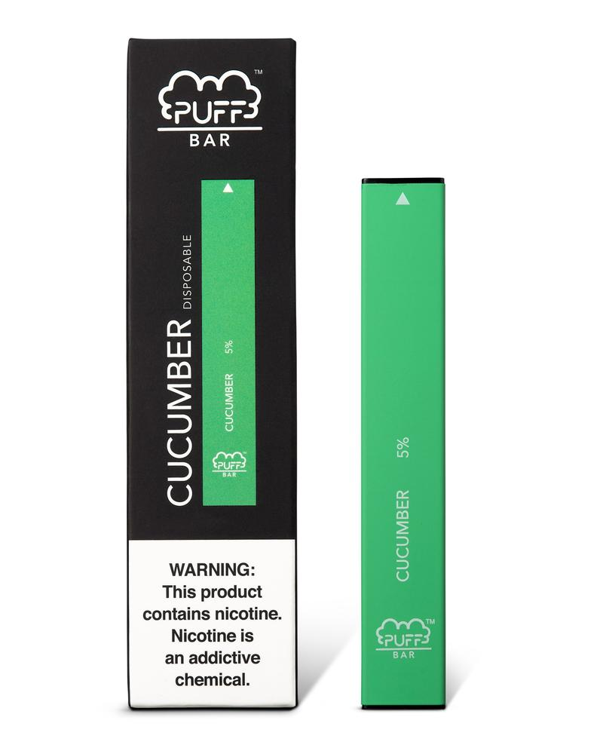
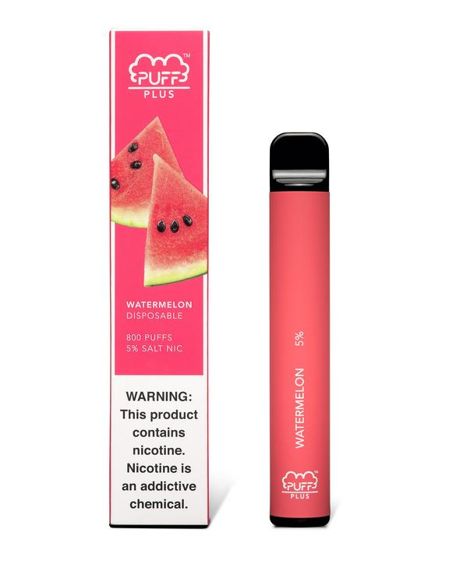
What are Vape Devices?
Some common names are Hooka Sticks, Cig-Alike, E-Cig, ENDS, Vape Pen,
  E-Hookah, Box Mod, Pen Mod, JUUL, etc.
  Manufacturers have a range of designs and ingredients.
Originally developed as what was mistakenly thought to be a safer alternative to regular cigarettes and as a way to assist smokers in cutting down/quitting
traditional cigarette
Pen-like refillable devices
Mods and tank systems
pod-based technology
Disposables

Slide 5
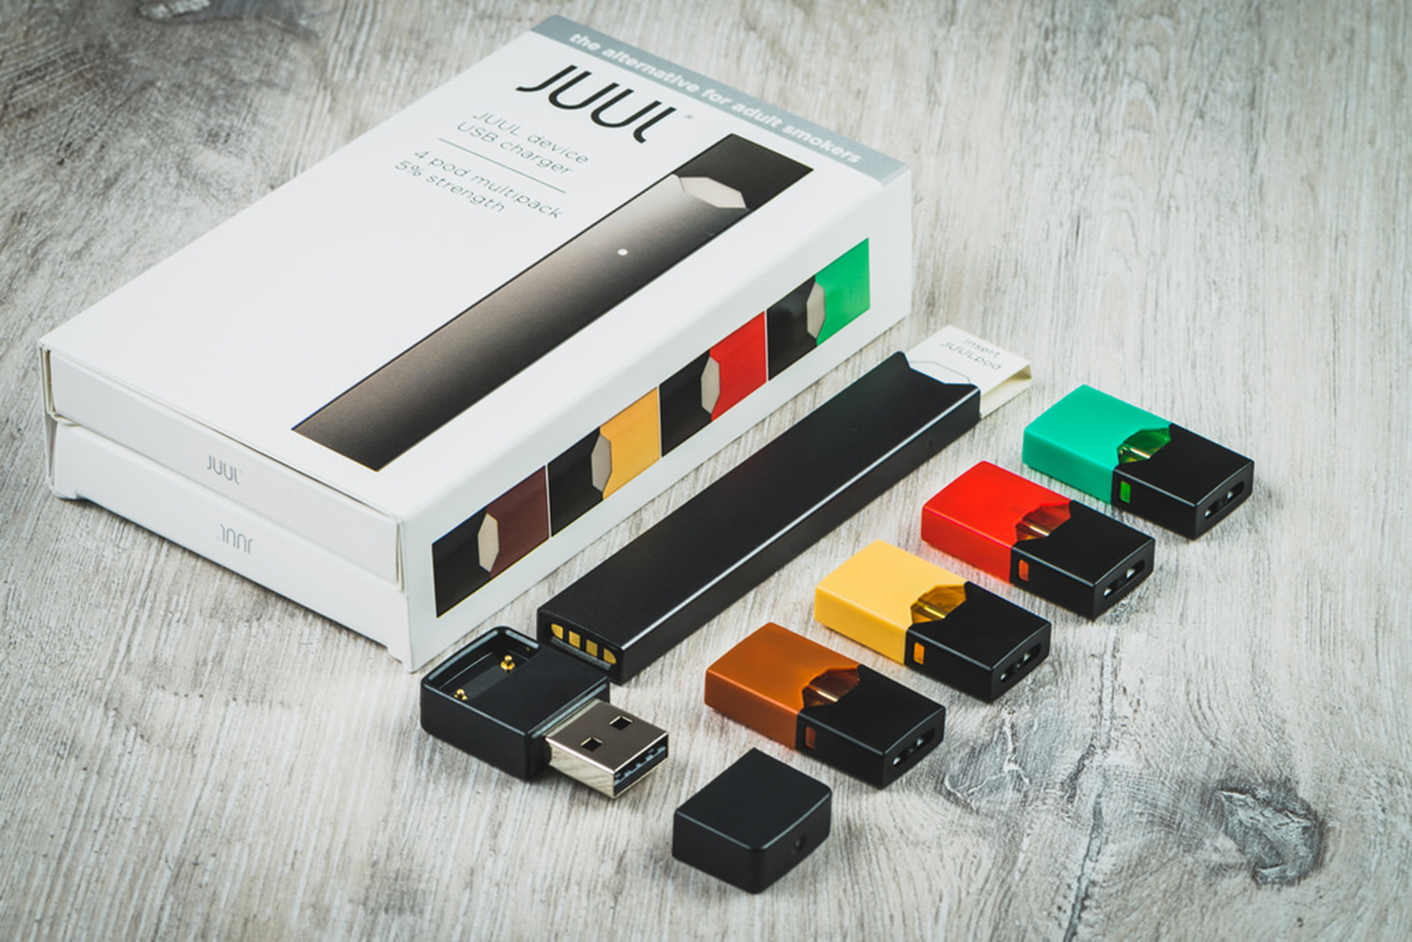
More About the JUUL
ALL JUUL products contain nicotine – many teens do not know that vaping has nicotine in it.
The nicotine in JUUL is a form of nicotine that is especially easily absorbed (nicotine salt) making it even more potent than other vape devices.
Many teens do not consider Juuling vaping. They use the term JUULing as a verb.
JUUL’s are sold at many local gas stations and mini markets.
JUUL pods can be hacked to add other liquids/drugs including THC the active ingredient in marijuana.

Slide 6
Health Issues – Vaping Nicotine
Nicotine is a powerful stimulant that is very highly addictive
(US Surgeon General)
Nicotine use in teens disrupts executive functioning and can prime the brain for other addictions (National Institute on Drug Abuse)
The nicotine strengths in vape products can be so strong they can cause nicotine overdose in youth (US Dept. of Health and Human Services)
Nicotine inflames lung tissue and reduces it’s ability to act as a barrier to foreign substances. (Irina Petrache, MD, lung specialist at Indiana University in Indianapolis)

Slide 7
Health Issues with Vape Pens:
Even without Nicotine
Lipid pneumonia is caused when lipids (which are, essentially, fatty acids) enter the lungs, causing the lungs to become inflamed. Some products in vapes contain vegetable glycerin, propylene glycol and vitamin e acetate; these are fatty acids. (health.com)
Vaping (even second hand vape exposure) is associated with bronchitis and asthma (American Journal of Respiratory and Critical Care Medicine)
Youth who vape are 7X more likely to smoke cigarettes (JAMA Pediatrics)
The aerosol in the vape cloud contains cancer causing chemicals such as benzene and chromium. (New England Journal of Medicine)
Vaping is associated with gum disease, tooth loss, bad breath
(Perio-implant Advisory)
Many vaping devices may be contaminated with harmful bacterial and fungal toxins (Harvard University)

Slide 8
Up to 800+ Puffs per disposable, approximately equivalent to 2 pack of cigarettes (40 cigarettes) $17.95
PUFF BAR DISPOSABLES
  Puff Barr’s have become popular due to being disposable, sleek and because the flavor ban loophole allows for these devices to have flavoring.

Slide 9
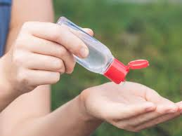

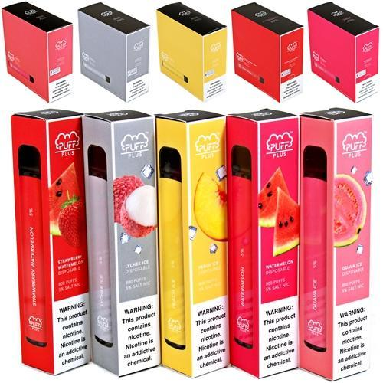
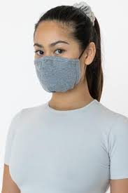
PUFF BAR DISPOSABLES
The PUFF BAR makes vaping a breeze. With over 20 flavors and 200-300 puffs, just open it, use it, and throw it away when done.

Slide 10

PUFF BAR DISPOSABLES REPLACING JUUL
Puff Bar sales have consistently been over $3 million a week since April, with volumes now over 300,000 sticks per week.
Credit...Gabriela Bhaskar for The New York Times, 6/2/20
Up to 800+ Puffs per disposable, approximately equivalent to 2 pack of cigarettes (40 cigarettes) $17.95

Slide 11


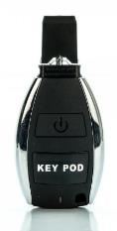
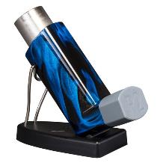
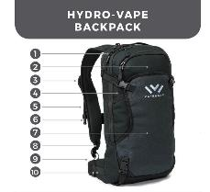
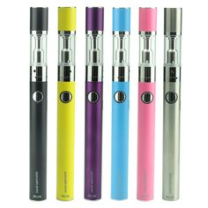
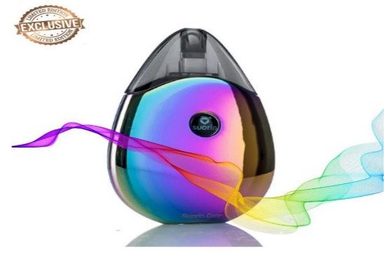
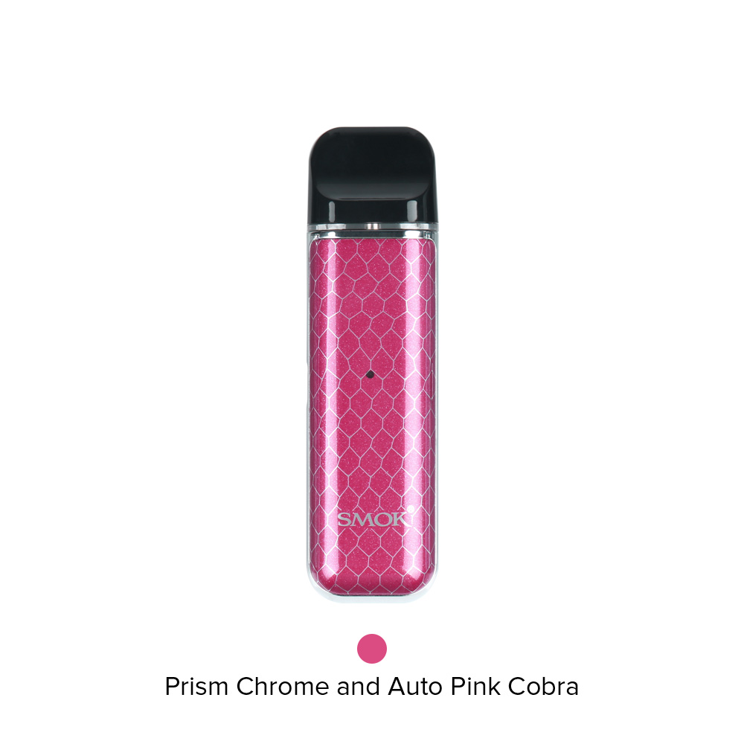
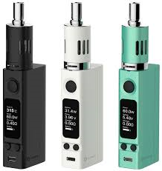
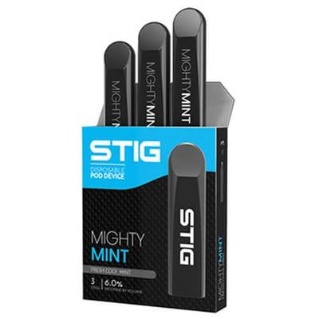
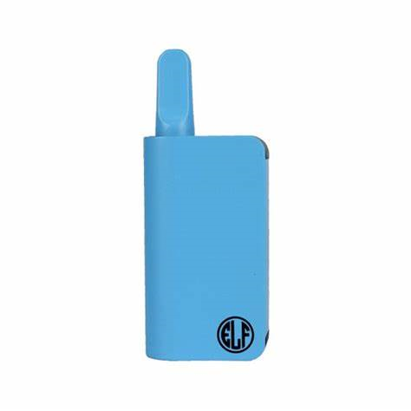
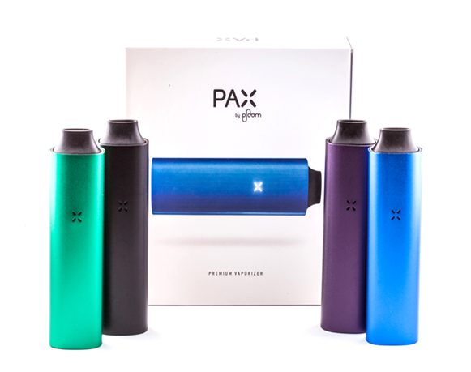
VAPING PRODUCTS

Slide 12
Vaping & Marijuana
Teens who use e- cigarettes are up to 4x more likely to use marijuana later
Easy to hide
Looks like common items such as pens, USB drives or a stylus pens
Easy to use in class, on the bus, anywhere
Reduced perception of harm
Smokeless and odorless

Slide 13
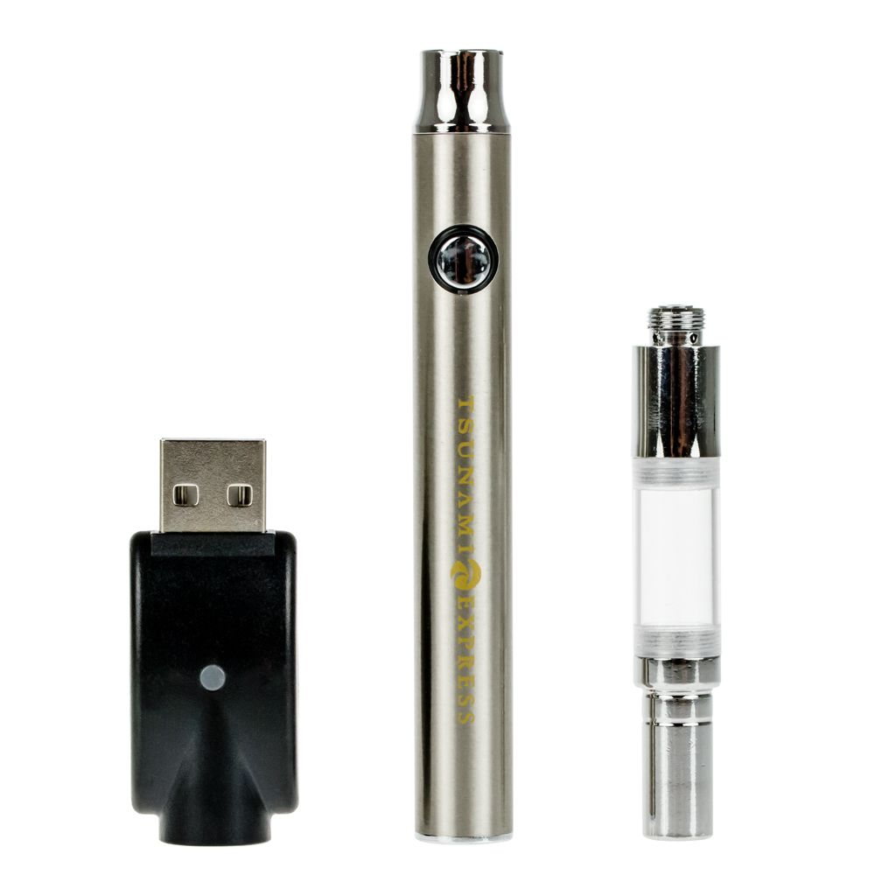
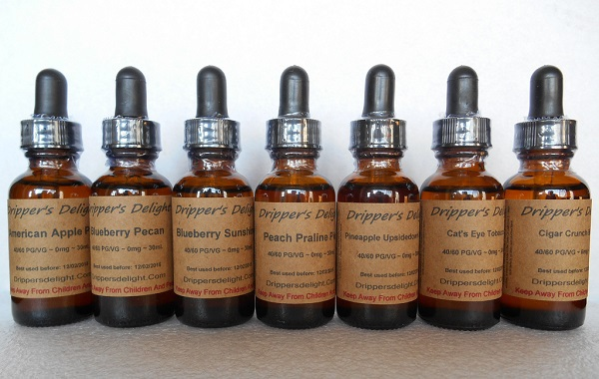
E-Juice/E-Liquids
The contents of E-liquids include nicotine, flavored chemicals and other chemicals
Some vaping products contain (or can be hacked to contain) marijuana or THC, the psychoactive ingredient in marijuana
E-juice with nicotine
Wax/hash oil/marijuana
  Vegetable glycerin
  Propylene glycol
  Flavoring
Charger
Battery
Cartridge
“Cart”

Slide 14
2,807 Vaping Related Lung Injury Cases In All
50 States, 2 US Territories
68 Deaths in 29 States
and
District of Columbia as of February 18, 2020
14

Slide 15
MONITORING THE FUTURE - 2019
20.3% of 8th graders have vaped nicotine
11.7% of 12th graders vape nicotine daily
The #1 reason teens report vaping is to experiment
The number one way youth obtain vapes is through social sources 72.6%

Slide 16
Social Media & Marketing
They have used the classic playbook used by the cigarette industries
Marketing to youth through social media such as Instagram, Twitter, Snapchap, TicTok
E-cig such as JUUL, trendy, cool, colorful and sleek products like Iphone.

Slide 17
Are e-cigarettes less harmful than cigarettes?
E-cigarettes almost always contain harmful ingredients including nicotine.
Acrolein, a known ingredient of many e-cigarettes, causes irreversible lung damage.
Nicotine exposure during adolescence can harm the developing brain.
No e-cigarette has been found to be safe and effective by FDA in helping smokers quit.

Slide 18
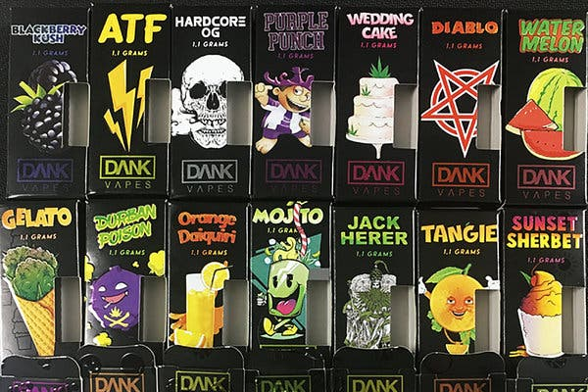
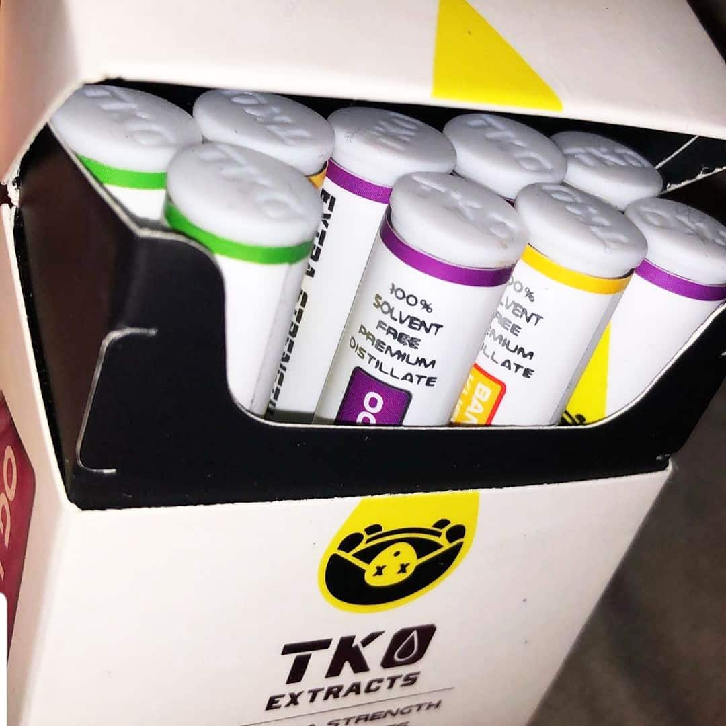
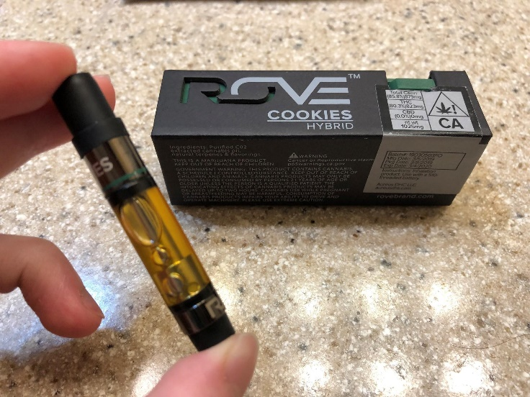
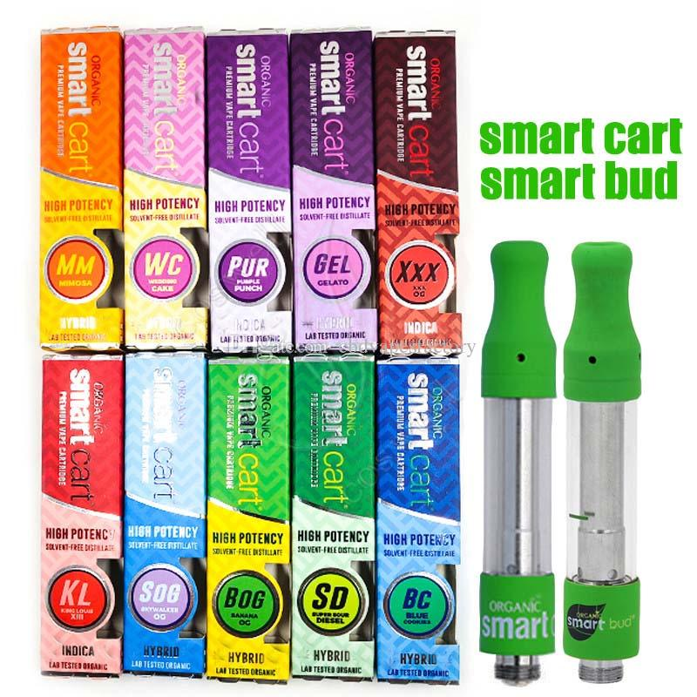
Black Market Products
Dank
TKO (15%)
Black Market
Products Most
Linked to EVALI
Rove (12%)
Smart Cart

Slide 19
WHY PARENTS SHOULD BE CONCERNED
Teens may have more difficulty stopping nicotine use because their developing brains become more conditioned to nicotine than adult brains.
Teens believe vaping is less harmful than smoking cigarettes.
Teens like the flavors they are inhaling.
Studies show that teens who vape are much more likely to start smoking cigarettes.
Packaging is enticing and doesn’t convey risk.
JUUL rebranded to make vaping a cooler alternative to cigarettes.

Slide 20
What parents can do
  Parents can be healthy role models and be tobacco free
  Encourage routines: exercise, regular meals, healthy amounts of sleep
Be flexible and start new routines so teens feel less anxious and more productive
Assist teens in planning and goal setting
Be positive, ex: I am really happy that I have this time to spend with you. Something I may not have had been able to do while working.
Connect with your teen via text messages. Share files and helpful information.

Slide 21
HOW TO HELP YOUR TEENAGER
Try to establish a healthy and trusting relationship
Listen & observe
Validate their feelings
Show trust
Connect & encourage
Give praise
Help your teen feel safe
Do things together – allow individual time with each child
Have family meals as frequently as possible
Limit exposure to news media

Slide 22
Before you have the conversation
Know the facts
Be patient and ready to listen
Set an example

Slide 23
TIPS FOR COMMUNICATING TO YOUR TEEN
Be patient
Be open
Be flexible

Slide 24
Know the Facts
E-cigarettes contain ingredients that are addictive and can harm different parts of the body.
E-cigarettes contain nicotine which can alter the brain and make cravings harder to ignore especially in the developing brain which is more vulnerable.
Nicotine interferes with executive functioning, memory and concentration.
E-cigarettes contain tiny particles that stay in the lungs causing harm. Exhaled vape exposes others to chemicals that are not safe to breathe.
Nicotine use trains the developing brain to more easily become addicted and to experiment with other drugs.

Slide 25
Quitting Nicotine
Prepare for physical and psychological withdrawal such as irritability, insomnia, changes in appetite, difficulty concentrating.
Teens typically find it difficult to taper use in order to quit.
Going “cold turkey” is usually the best route but difficult.
The onset and duration of nicotine withdrawal varies.
Withdrawal effects are temporary but uncomfortable therefore some teens might benefit from nicotine gum, the patch, or another cessation product (a health care professional should be consulted).
If a teen becomes agitated or aggressive contact his/her doctor or other health care professional.

Slide 26
CURRENT PREVENTION STRATEGIES
Schools, coalitions and others have been offering educational classes and assemblies, classroom discussion, referring students for help.
Prevention is a lot easier than treatment. Student Assistance Services, shout out to Judy Mezey designed “Escape The Vape Room” a fun interactive game that provides facts about vaping.
“Hidden In Plain Sight” is a mock teenager’s bedroom set up with various vaping and drug related items to educate parents.
Peer education, support, and opportunities to be creative in educating peers provided by school and community clubs and groups can play an important role.
Leadership programs such as Y2Y (Youth to Youth) and SADD (Students Against Destructive Decisions) clubs promote healthy alternatives to substance use.

Slide 27
Resources for Parents and Teens
Thisisquitting.com
The Teen Vaping Trend – What Parents Need to Know, https://drugfree.org/parent-blog/the-teen-vaping-trend-what -parents-need-to=know
How to Talk With Your Kids About Vaping https://drugfree.org/parent-blog/how-blog/how-to-talk-with-your-kids-about-vaping-guide/the-teen-vaping-trend-what -
The Truth Initiative:therealcost.betobaccofree.hhs.gov/

Slide 28
Resources for Parents on Talking to their Kids about Vaping
The Vape Talk (Lung Association)
E-cigarettes and Youth: What Parents Need to Know (PDF) (CDC)
Talk with your teen about e-cigarettes: A tip sheet for parents (PDF)
(Surgeon General)
Vaping: What You Need to Know and How to Talk With Your Kids (PDF) (Partnership for Drug-Free Kids)

